Slide 1

CSS SELECTORS
C# - MODULE 4, DAY 2

Slide 2

HTML / CSS REVIEW

Slide 3
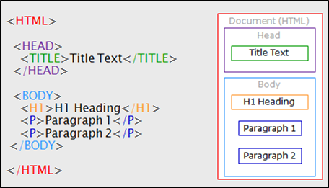
HTML STRUCTURE
Notes:
Review the hierarchical nature of an HTML Document, including parents, descendants, and siblings.

Slide 4
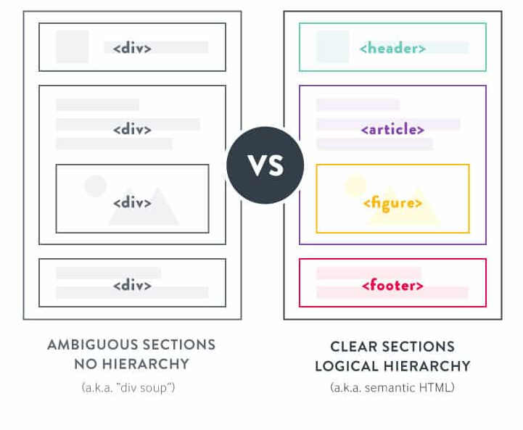
SEMANTIC HTML
Notes:
Review the hierarchical nature of an HTML Document, including parents, descendants, and siblings.

Slide 5
TAGS I WANT YOU TO KNOW
div
input
img
form
label
nav
a
header
footer
main
aside
article
section
Did you know that the <article> tag represents a stand-alone document within a page? Content in here would similar to a newspaper article or blog.

Slide 6
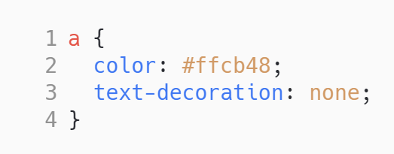
CSS STRUCTURE
Selector
Rules
Did you know that there is a css property to make the text appear bold? It is called font-weight.
Notes:
CSS Rules
selector
declaration block
Selectors
universal
element
id
class
descendant combinator
descendant selector (space)
child selector (>)
adjacent sibling selector (+)
general sibling selector(~)
pseudo-class (e.g. a:hover)
Create a system that organizes the rules to keep organized

Slide 7
HTML / CSS QUIZ

Slide 8

DON’T FORGET
TO RECORD

Slide 9

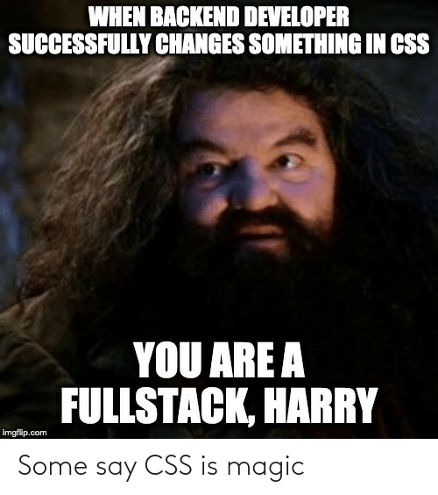
AGENDA
HTML Document Hierarchy
The Box Model
Display
Position
Float
Measurement
Advanced CSS Selectors

Slide 10
HTML Hierarchy

Slide 11
HTML Element Hierarchy
Each HTML element has a hierarchical relationship with other elements.
All elements, except the root element (<html>) has a single parent element
A Parent is the element that the current element is included in.
Elements can have 0...n child elements
Children are elements included in the current element.
Elements can have 0...n sibling elements
Sibling elements are elements with the same parent

Slide 12
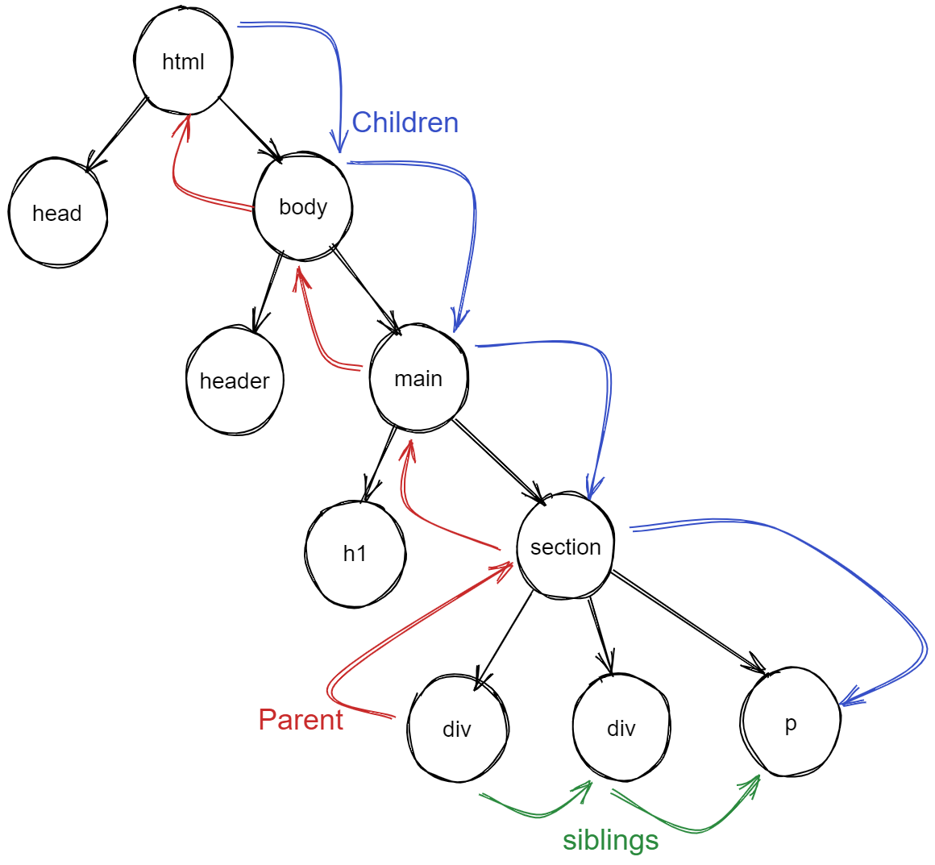
<html>
<head></head>
<body>
<header></header> <main> <h1></h1>
<section>
<div></div>
<div></div>
<p></p>
</section>
</main>
</body>
</html>

Slide 13
LAYOUT

Slide 14
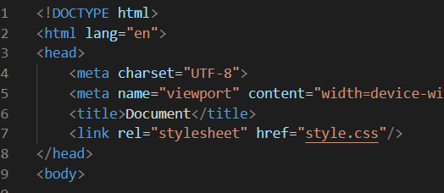
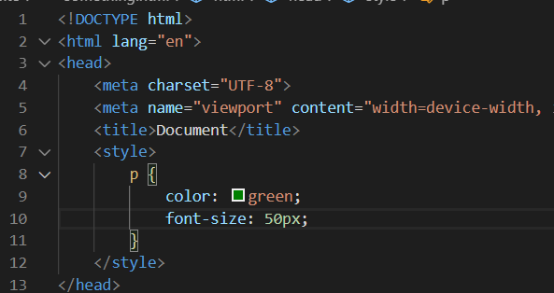
Including CSS
CSS Can be included in HTML in 3 ways
inline on an HTML tag using the style attribute
<p style=”color:green; font-size:50px;”>Hello</p>
Within the head of the document in a <style></style> element
3. As a link to an external CSS document

Slide 15
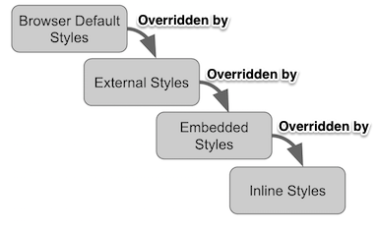
Cascade
Cascading Order
Highest Priority
Inline Styles
Internal Styles
External Styles
Browser defaults
Last Rule
If two selectors are identical, the later of the two will be applied
Specific
The most specific selector will be applied. h1 {} is more specific than * {}
!Important
indicates that this rule is more important than previous rules that may be applied.
Cascade: All CSS applied to an element, including from multiple style sheets, are brought together and then the most specific applied.

Slide 16
CSS Selectors
<div>
<span class=”spanOne”>
<div id=”divThree”>
Universal Selector: *
Element Selector: div
Class Selector: .spanOne
Id Selector: #divThree
List of Pseudo-classes
Selector CodePen

Slide 17
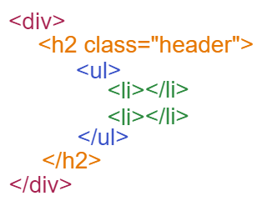
CSS Selectors
>
CSS Selectors can be combined to achieve greater specificity
div h2.header ul > li {
background-color: red;
}
This selector will select all li elements that are a child of an ul that is a descendent of an h2 element that has the .header class applied to it, that is a descendent of a div

Slide 18
CSS Selectors continued...
Universal Selector: *
Element Selector: div
Class Selector: .spanOne
Id Selector: #divThree
Descendent Combinator: .special h2
Child Selector: #divThree > span
Adjacent Sibling Selector: .spanOne + span
(aka immediately following)
General Sibling Selector: .spanTwo ~ span
Pseudo-class Selector: div :first-child div :last-child div :nth-child(2) div:hover
List of Pseudo-classes
Selector CodePen

Slide 19
BOX MODEL

Slide 20
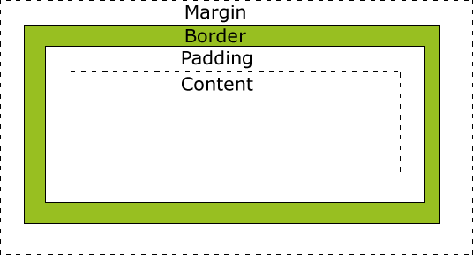
BOX MODEL
Every element in web design is a rectangular box.
The content, padding, border, and margin can be used to calculate the amount of space that an element takes up.
Margin is the space outside an element. It does not affect the size of the box but affects other content that interacts with the box.
Padding is the space inside an element.

Slide 21
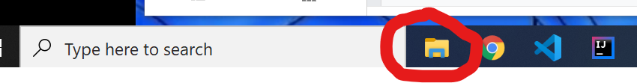
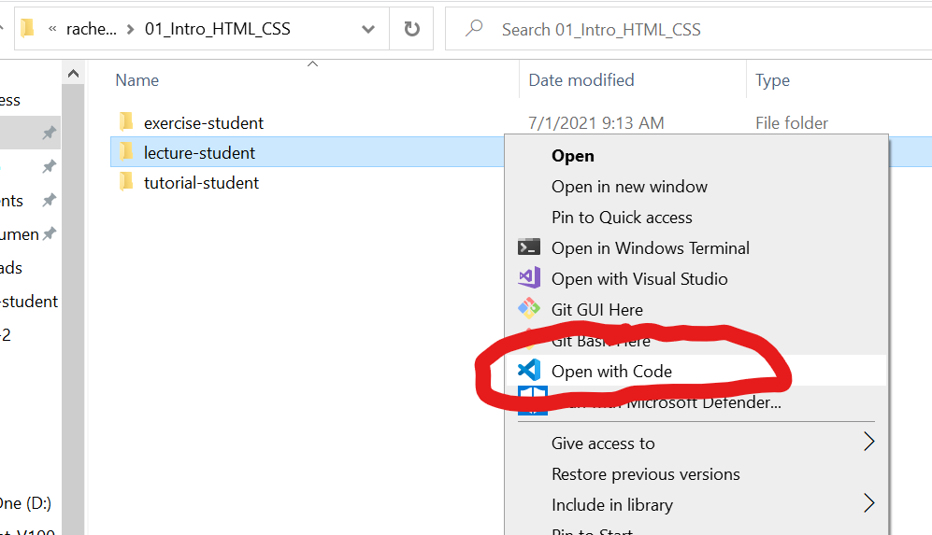
Let’s head to the code
Go to file explorer
Navigate to the lecture-student
Right click lecture-student folder
Select Open with Visual Studio Code
02_CSS_Selectors

Slide 22
CHROME DEV TOOLS

Slide 23
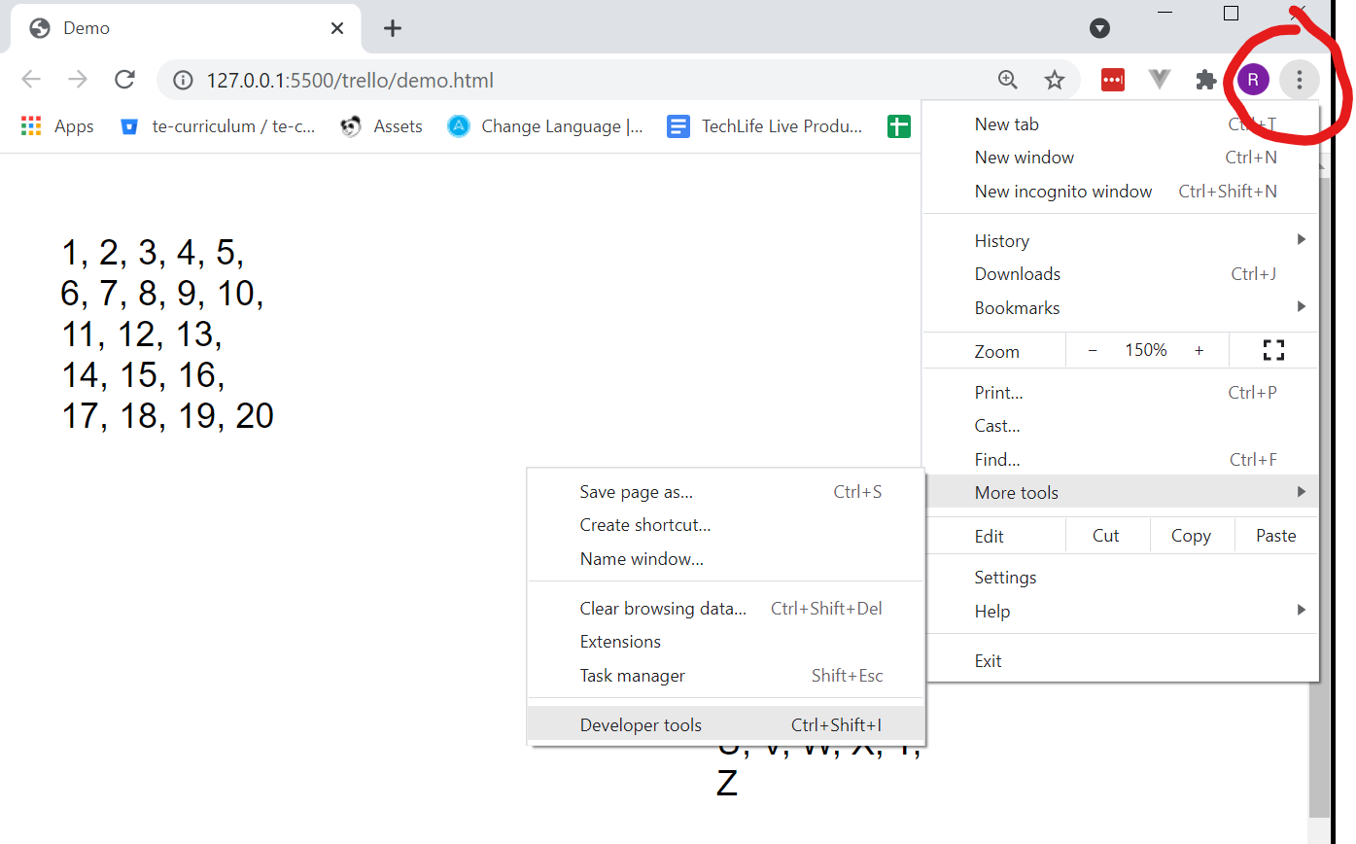
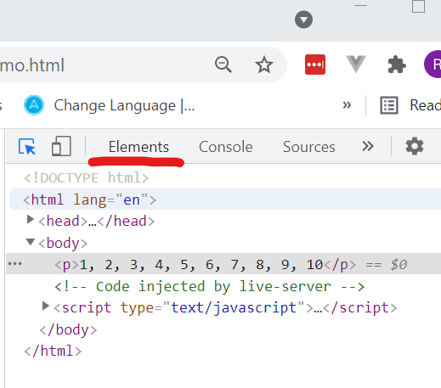
Chrome Dev Tools

Slide 24
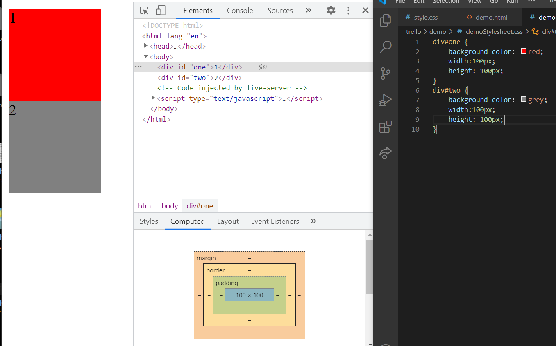

Slide 25
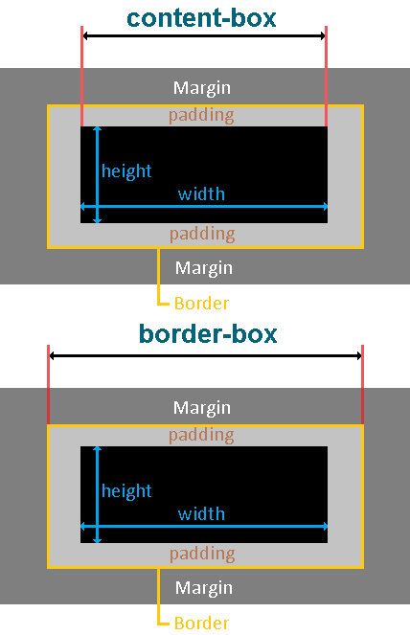
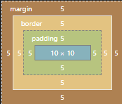
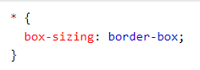
BOX-SIZING
https://www.w3schools.com/css/css3_box-sizing.asp
Notes:
box-sizing: content-box|border-box|initial|inherit tells the browser what sizing properties it should include.

Slide 26
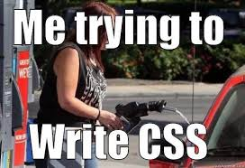
BREAK
DON’T FORGET TO PAUSE/UNPAUSE RECORDING

Slide 27
DISPLAY

Slide 28
DISPLAY: BLOCK
A block-level element always starts on a new line and takes up the full width available—meaning it stretches out to the left and right as far as it can.
default for: div, h1, p, form, header, footer, section, etc.
block
Starts on a newline
Takes up full available width
can set width/ height
content
a

Slide 29
DISPLAY: INLINE
inline
Starts on same line
Takes up only width required for content
It accepts margin and padding while ignoring height and width
An inline element does not start on a new line and only takes up as much width as necessary.
default for: span, em, etc.
content
a
Notes:
inline is the default value for elements like <span> and <em>.
It accepts margin and padding while ignoring height and width.

Slide 30
DISPLAY: INLINE-BLOCK
Similar to inline, but allows you to set a width and height
inline-block
Like inline
Can set width/height
content
a

Slide 31

DISPLAY: NONE

Slide 32

SIZE UNITS
px - Pixels (1px = 1/96th of 1in)
*(px) are relative to the viewing device.
em - Relative to this element
rem - Relative to the document root
% - Percentage adjustments
pt - Points (1pt = 1/72 of 1in)
in - Inches
… way too many more.
https://www.w3schools.com/css/css_units.asp
Notes:
box-sizing: content-box|border-box|initial|inherit tells the browser what sizing properties it should include.

Slide 33
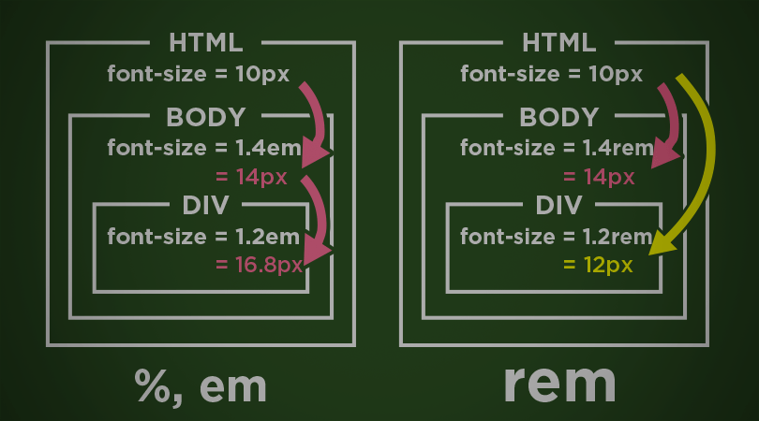
EM vs REM
Notes:
box-sizing: content-box|border-box|initial|inherit tells the browser what sizing properties it should include.

Slide 34
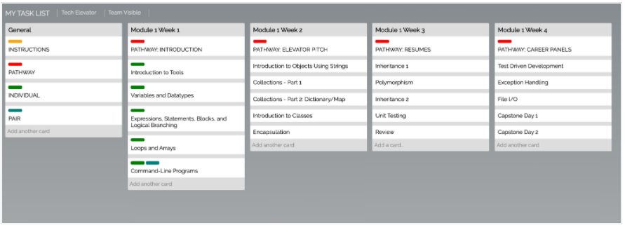

Slide 35
Let’s head to the code
Go to file explorer
Navigate to the lecture-student
Right click lecture-student folder
Select Open with Visual Studio Code
02_CSS_Selectors

Slide 36
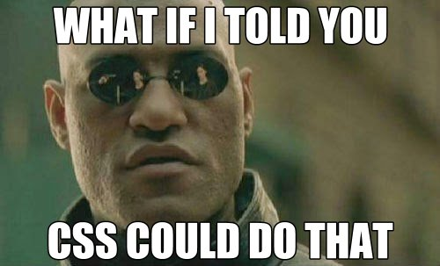
BREAK?
DON’T FORGET TO PAUSE/UNPAUSE RECORDING

Slide 37
POSITIONING
Notes:
The normal flow of a page is for elements to appear left to right and top to bottom based on the order in which they appear in the HTML document and the rules of block and inline display.
Static position by default means the element conforms to normal flow.
Relative position means relative to where it would otherwise be positioned in the normal flow.
You can set the top, right, bottom, and left positioning attributes.
Absolute position places the element relative to the parent ancestor—that is, the containing element—exactly where you specify.
These elements are removed from the flow of the page.
Setting both top and bottom, or both left and right allows you to "stretch" an element's dimensions.
Fixed position is relative to the browser window and does not scroll with the page.
You can set the top, right, bottom, and left positioning attributes.

Slide 38
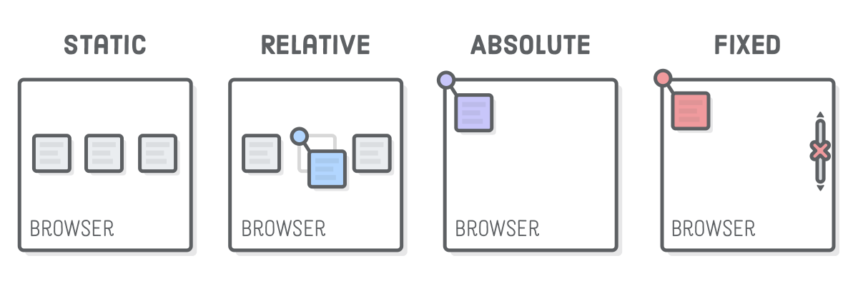
POSITION
The normal flow of a page is for elements to appear left to right and top to bottom based on the order in which they appear in the HTML document and the rules of block and inline display.
Static position by default means the element conforms to normal flow.

Slide 39
POSITION
Relative position means relative to where it would otherwise be positioned in the normal flow.
You can set the top, right, bottom, and left positioning attributes.

Slide 40
POSITION
Absolute position places the element relative to the parent ancestor—that is, the containing element—exactly where you specify. If its it parent is the document body, it will move along with page scrolling.
These elements are removed from the flow of the page.
You can set the top, right, bottom, and left positioning attributes

Slide 41
POSITION
Fixed position is relative to the browser window and does not scroll with the page.
You can set the top, right, bottom, and left positioning attributes, Not setting a location causes the element to be fixed to wherever it normally shows up on the page.

Slide 42

BONUS
FLOAT
Notes:
The float property specifies if the element should be taken from the normal flow and placed along the left or right side of the container. Text and inline elements wrap around it.
The float property can have several values:
none: element does not float.
left: element floats to the left of its container.
right: element floats to the right of its container.
inherit: element inherits the float direction of its parent.
Floated elements automatically display as block.
Floats should be avoided in modern web applications. In most cases, they were historically used to create multi-column layouts in older browsers.

Slide 43
Float
Mostly obsolete due to grid and flexbox, but sometimes still useful for quick columns. Float must be applied to both the left and right element.
float: left
float: right
float: right
float: left

Slide 44
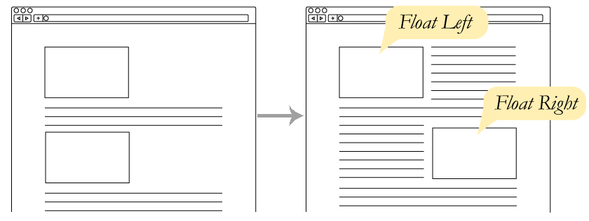
FLOAT

Slide 45
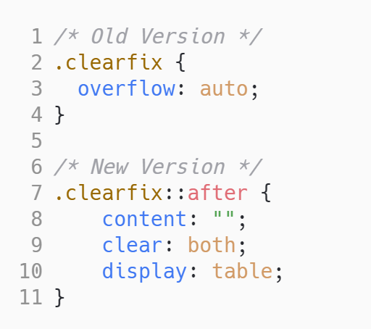
.CLEARFIX
BONUS
https://www.w3schools.com/howto/howto_css_clearfix.asp

Slide 46
BOOK & CHEAT SHEET
https://www.adtrak.co.uk/blog/the-ultimate-css-selectors-cheatsheet
https://flukeout.github.io/

Slide 47
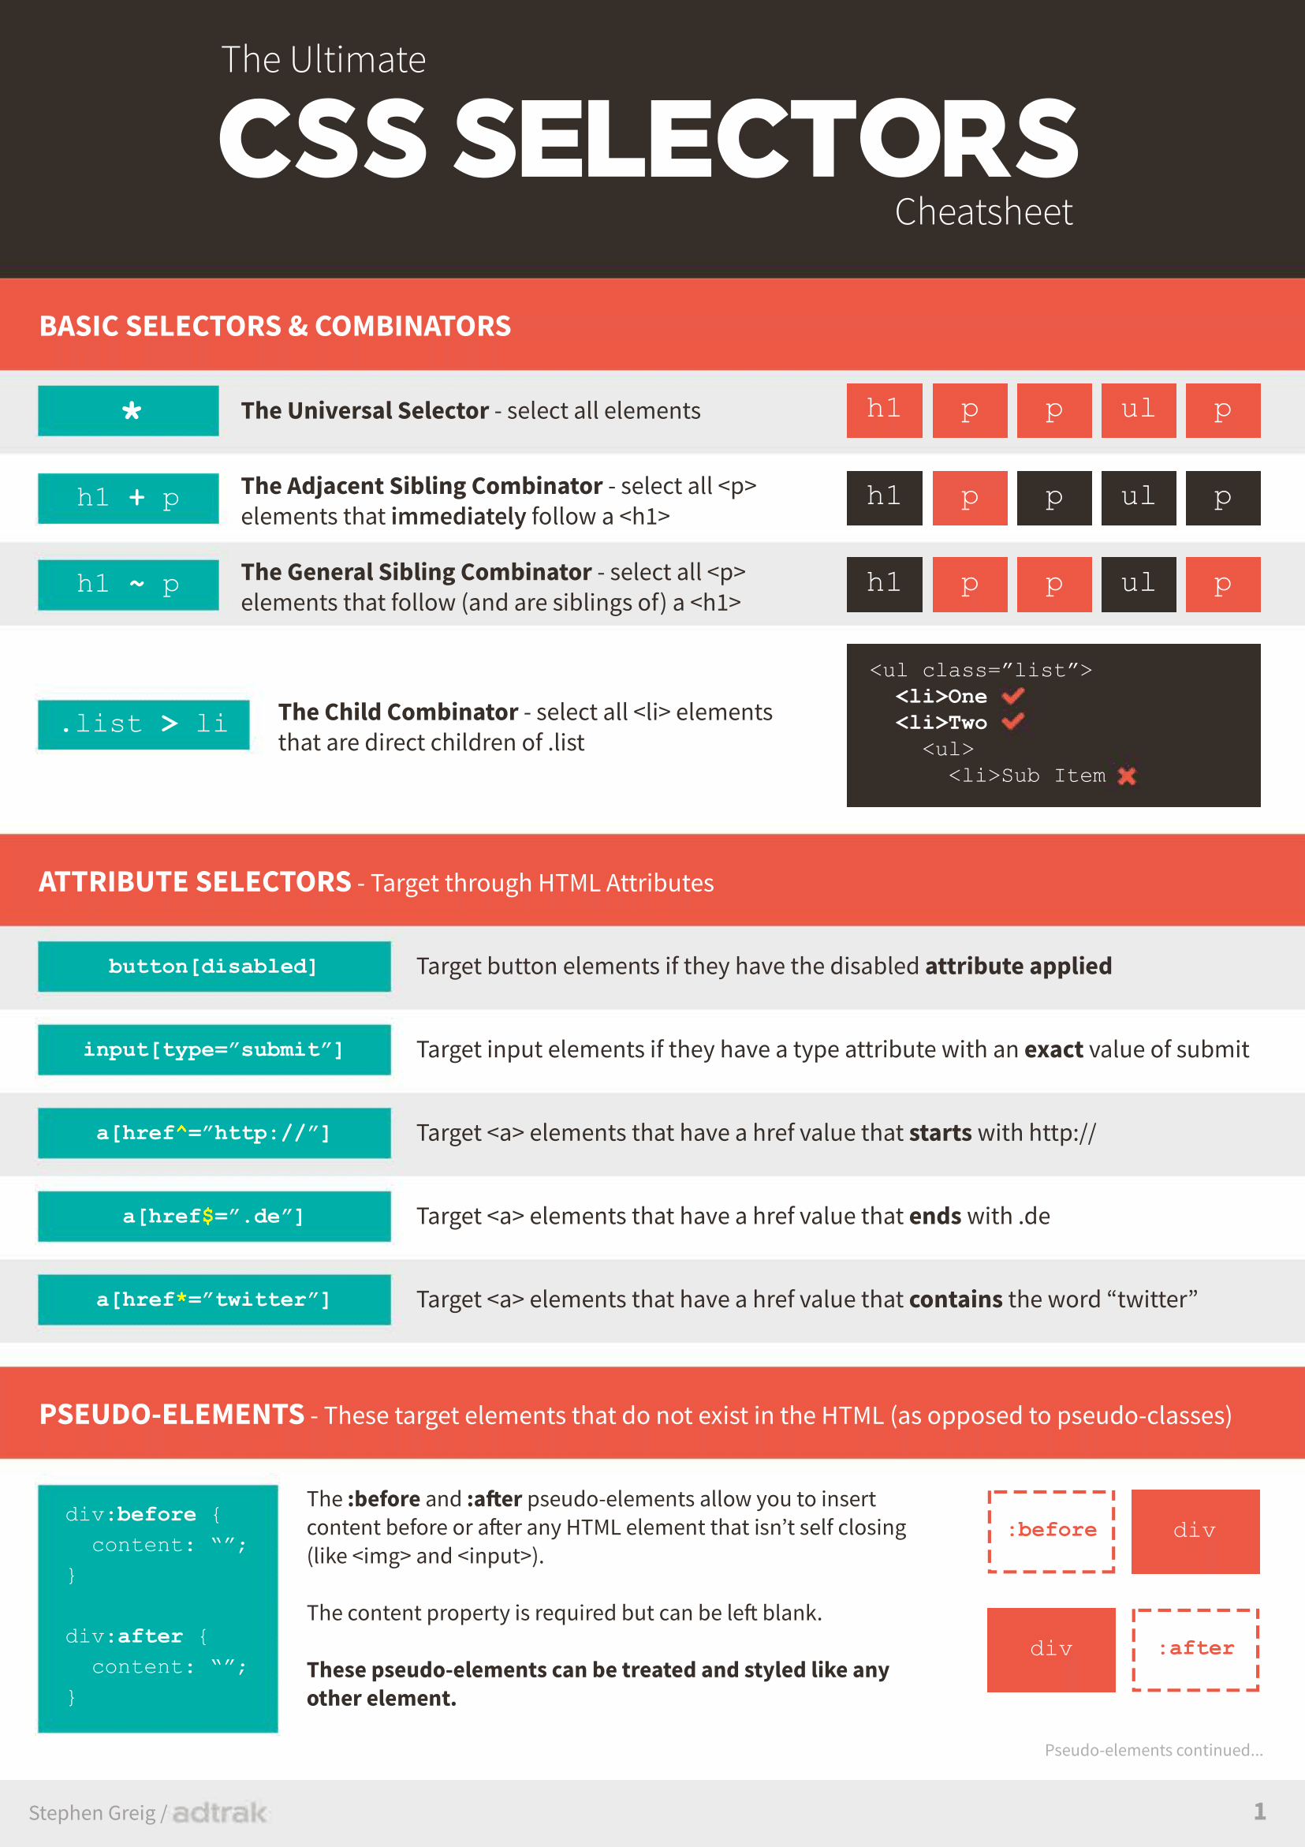
CHEAT SHEET
Notes:
https://www.adtrak.co.uk/blog/the-ultimate-css-selectors-cheatsheet

Slide 48
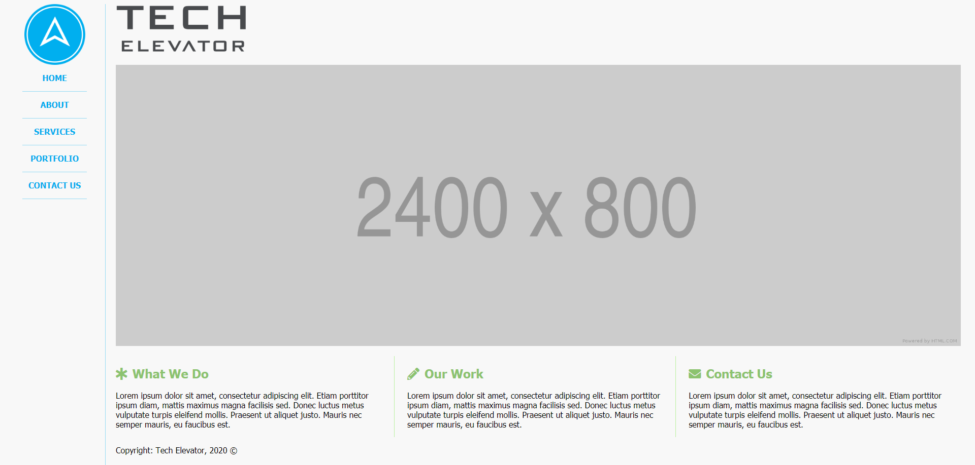
STUDENT EXERCISE

Slide 49

HAPPY CODING!

